Slide 1
Computer Graphics (CSE2066)
2D Geometric Transformations
Translation, Scaling, Rotation in computer Graphics

Slide 2
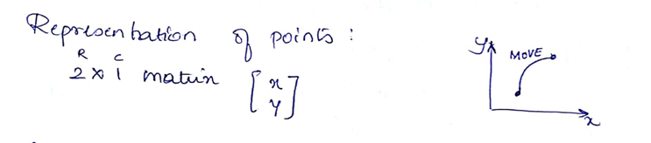
2D Geometric Transformations:
In Computer graphics, Transformation is a process of modifying and re-positioning the existing graphics.
2D Transformations take place in a two dimensional plane
Transformations are helpful in changing the position, size, orientation, shape etc of the object.

Slide 3
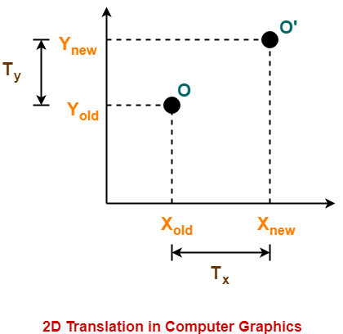
Two-Dimensional Translation:
In Computer graphics, 2D Translation is a process of moving an object from one position to another in a two dimensional plane.
Consider a point object O has to be moved from one position to another in a 2D plane.
Let-
Initial coordinates of the object O = (X_{old}, Y_{old})
New coordinates of the object O’ after translation = (X_{new}, Y_{new})
Translation vector or Shift vector = (T_{x}, T_{y})
Given a Translation vector (T_{x}, T_{y})
T_{x} defines the distance the X_{old} coordinate has to be moved.
T_{y} defines the distance the Y_{old} coordinate has to be moved.

Slide 4
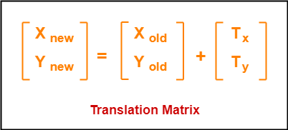

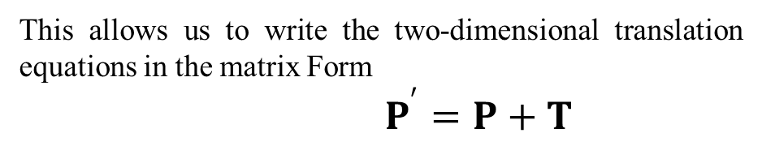
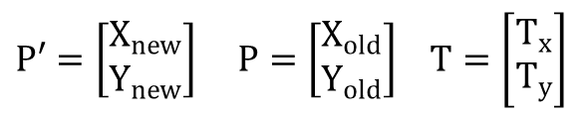

This translation is achieved by adding the translation coordinates to the old coordinates of the object as-
X_{new} = X_{old} + T_{x} (This denotes translation towards X axis)
Y_{new} = Y_{old} + T_{y} (This denotes translation towards Y axis)
In Matrix form, the above translation equations may be represented as
The translation values of X_{new} and Y_{new} is calculated as
$$X_{new}=X_{old}+T_{x}$$
$$Y_{new}=Y_{old}+T_{y}$$
The translation distance pair (T_{x},T_{y}) is called a translation vector or shift vector Column vector representation is given as
$P′=\left[\begin{matrix}X_{new} \\ Y_{new}\end{matrix}\right]$ $P=\left[\begin{matrix}X_{old} \\ Y_{old}\end{matrix}\right]$ $T=\left[\begin{matrix}T_{x} \\ T_{y}\end{matrix}\right]$
This allows us to write the two-dimensional translation equations in the matrix Form
$P^{′}=P+T$

Slide 5
Problem-01:
Given a circle C with radius 10 and center coordinates (1, 4). Apply the translation with distance 5 towards X axis and 1 towards Y axis. Obtain the new coordinates of C without changing its radius.
Solution-
Given-
Old center coordinates of C = (X_{old}, Y_{old}) = (1, 4)
Translation vector = (T_{x}, T_{y}) = (5, 1)
Let the new center coordinates of C = (X_{new}, Y_{new}).
Applying the translation equations, we have-
X_{new} = X_{old} + T_{x} = 1 + 5 = 6
Y_{new} = Y_{old} + T_{y} = 4 + 1 = 5
Thus, New center coordinates of C = (6, 5).

Slide 6
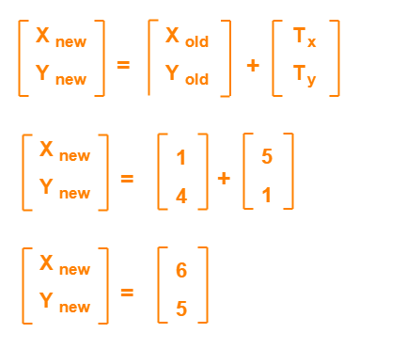
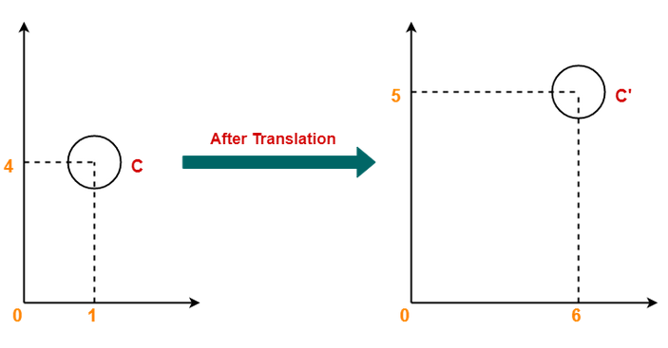
In matrix form, the new center coordinates of C after translation may be obtained as
Thus, New center coordinates of C = (6, 5)

Slide 7
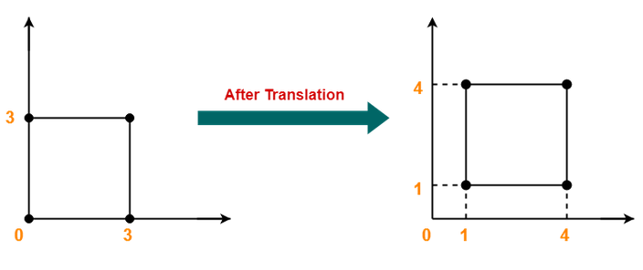
Problem-02:
Given a square with coordinate points A(0, 3), B(3, 3), C(3, 0), D(0, 0). Apply the translation with distance 1 towards X axis and 1 towards Y axis. Obtain the new coordinates of the square.
Solution:

Slide 8
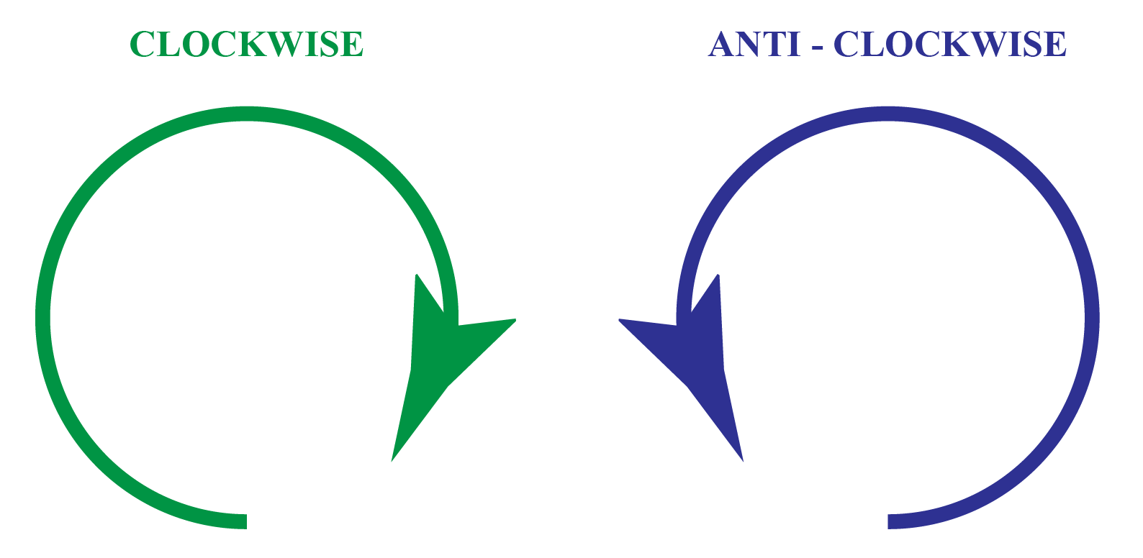
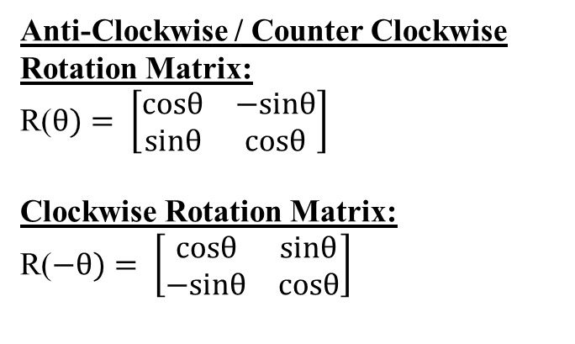
Two-Dimensional Rotation
In Computer graphics, 2D Rotation is a process of rotating an object with respect to an angle in a two dimensional plane.
Anti-Clockwise / Counter Clockwise Rotation Matrix:
R($θ)= \left[\begin{matrix}cosθ & −sinθ \\ sinθ & cosθ\end{matrix}\right]$
Clockwise Rotation Matrix:
R($−θ)= \left[\begin{matrix}cosθ & sinθ \\ −sinθ & cosθ\end{matrix}\right]$

Slide 9
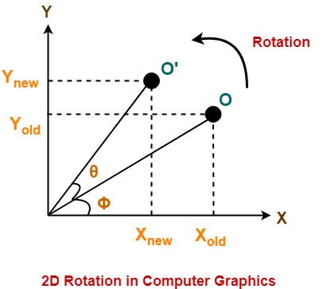
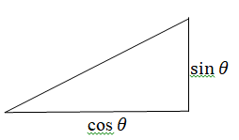
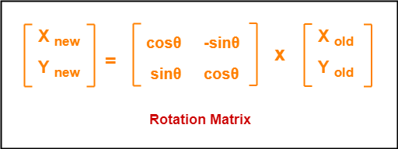
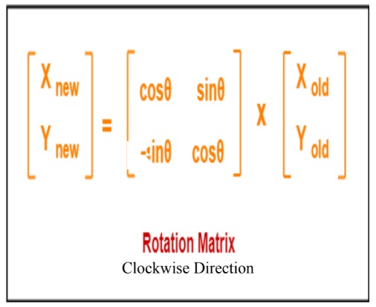
Consider a point object O has to be rotated from one angle to another in a 2D plane.
Let-
Initial coordinates of the object O = (X_{old}, Y_{old})
Initial angle of the object O with respect to origin = Φ
Rotation angle = θ
New coordinates of the object O’ after rotation = (X_{new}, Y_{new})
This rotation is achieved by using the following rotation equations
X_{new} = X_{old} x cosθ – Y_{old} x sinθ
Y_{new} = X_{old} x sinθ + Y_{old} x cosθ
In Matrix form, the above rotation equations may be represented as
Anti-Clockwise Direction
Clockwise Direction

Slide 10

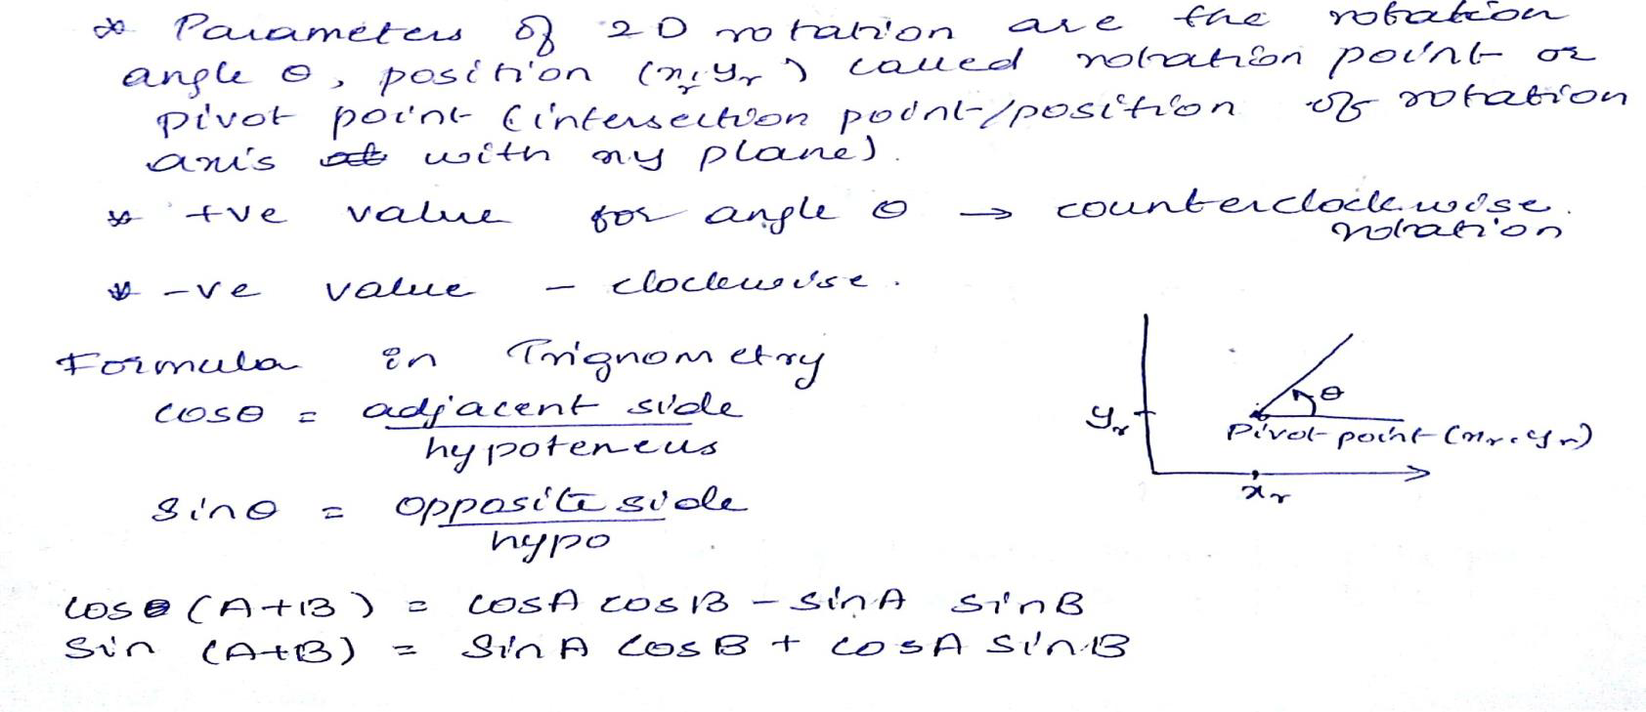
We can write the rotation equations in the matrix form
P’ = R· P
Where the rotation matrix is
For Brief Calculation read below procedure (for reference purpose only)

Slide 11
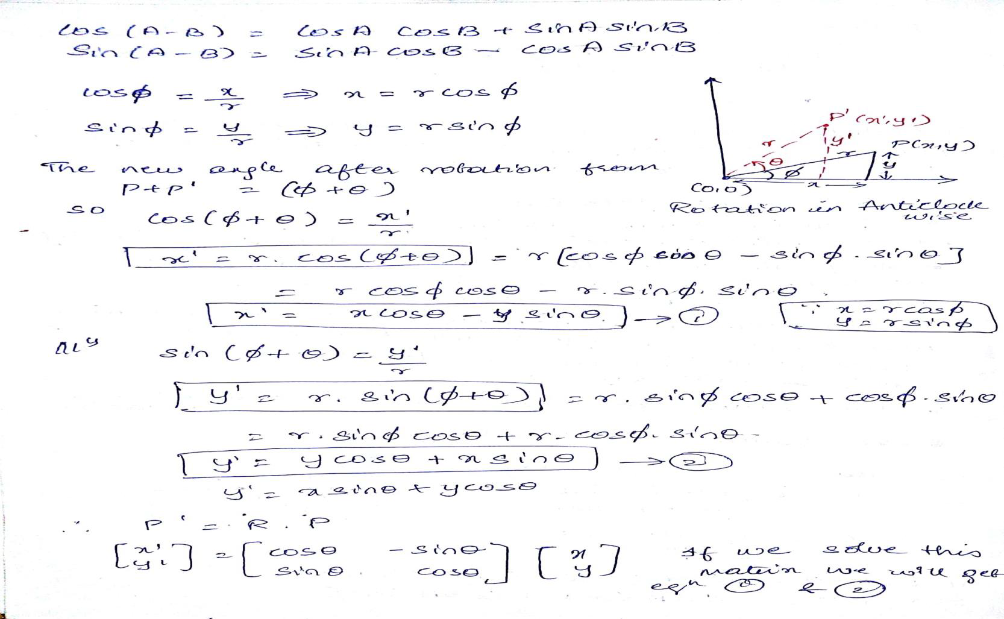
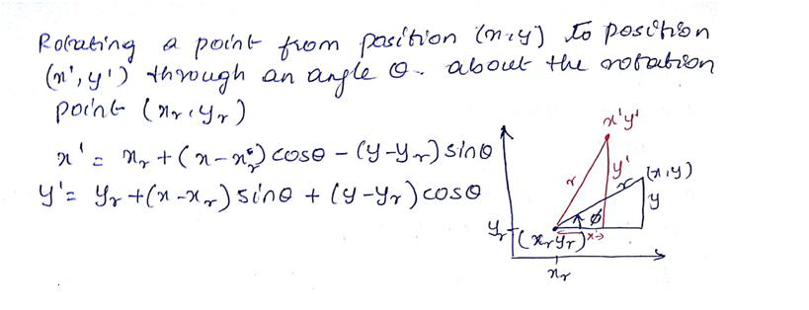

Slide 12
Problem-01:
Given a line segment with starting point as (0, 0) and ending point as (4, 4). Apply 30 degree rotation anticlockwise direction on the line segment and find out the new coordinates of the line.
Given-
Old ending coordinates of the line = (X_{old}, Y_{old}) = (4, 4)
Rotation angle = θ = 30º
Let new ending coordinates of the line after rotation = (X_{new}, Y_{new}).
Applying the rotation equations, we have
X_{new}
= X_{old} x cosθ – Y_{old} x sinθ
= 4 x cos30º – 4 x sin30º
= 4 x (√3 / 2) – 4 x (1 / 2)
= 2√3 – 2
= 2(√3 – 1)
= 2(1.73 – 1)
= 1.46
Y_{new}
= X_{old} x sinθ + Y_{old} x cosθ
= 4 x sin30º + 4 x cos30º
= 4 x (1 / 2) + 4 x (√3 / 2)
= 2 + 2√3
= 2(1 + √3)
= 2(1 + 1.73)
= 5.46
Thus, New ending coordinates of the line after rotation = (1.46, 5.46).

Slide 13
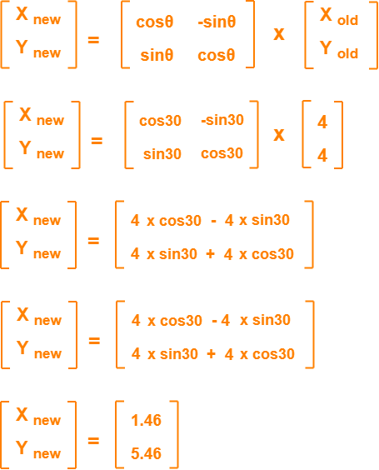
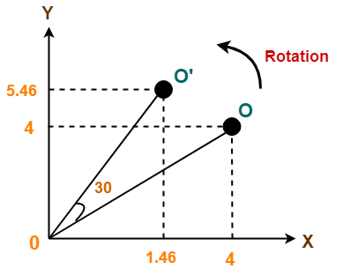
Alternatively,
In matrix form, the new ending coordinates of the line after rotation may be obtained as-
Thus, New ending coordinates of the line after rotation = (1.46, 5.46).

Slide 14
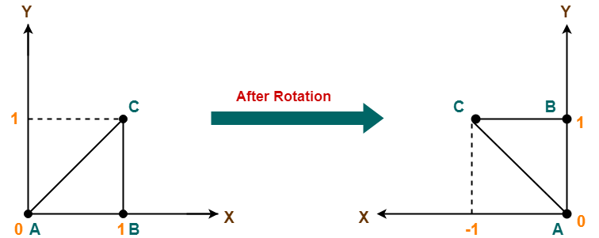
Problem-02:
Given a triangle with corner coordinates (0, 0), (1, 0) and (1, 1). Rotate the triangle by 90 degree anticlockwise direction and find out the new coordinates.
Solution:

Slide 15
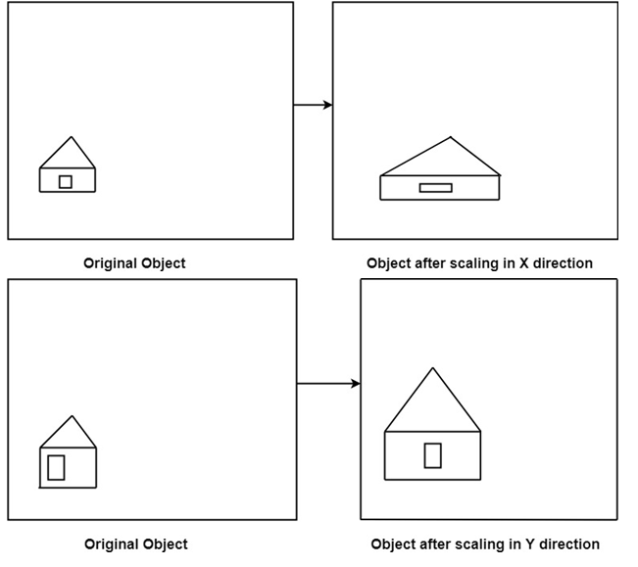
Two-Dimensional Scaling
In computer graphics, scaling is a process of modifying or altering the size of objects.
Scaling may be used to increase or reduce the size of object.
Scaling subjects the coordinate points of the original object to change.
Scaling factor determines whether the object size is to be increased or reduced.
If scaling factor > 1, then the object size is increased.
If scaling factor < 1, then the object size is reduced.

Slide 16
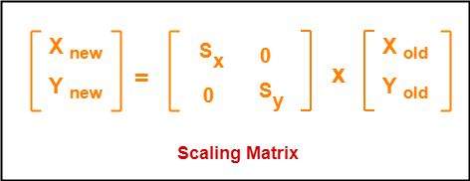
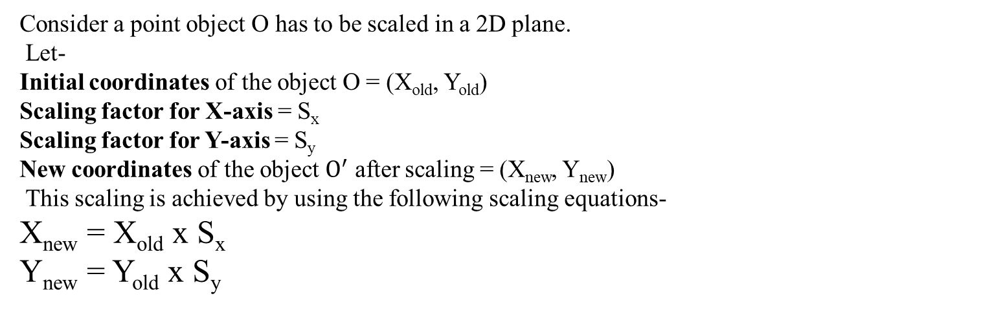
Consider a point object O has to be scaled in a 2D plane.
Let-
Initial coordinates of the object O = (X_{old}, Y_{old})
Scaling factor for X-axis = S_{x}
Scaling factor for Y-axis = S_{y}
New coordinates of the object $O^{′}$ after scaling = (X_{new}, Y_{new})
This scaling is achieved by using the following scaling equations-
X_{new} = X_{old} x S_{x}
Y_{new} = Y_{old} x S_{y}
In Matrix form, the above scaling equations may be represented as-
Note:
Specifying a value of 1 for both Sx and Sy leaves the size of objects unchanged.
Uniform Scaling: Both S_{x} & S_{y} are assigned to same value.
Differential Scaling: Both S_{x} & S_{y} are assigned to different value. (i.e., values are not same)

Slide 17
Problem:
Given a square object with coordinate points A(0, 3), B(3, 3), C(3, 0), D(0, 0). Apply the scaling parameter 2 towards X axis and 3 towards Y axis and obtain the new coordinates of the object.
Solution:
Given-
Old corner coordinates of the square = A (0, 3), B(3, 3), C(3, 0), D(0, 0)
Scaling factor along X axis = 2
Scaling factor along Y axis = 3
For Coordinates A(0, 3)
Let the new coordinates of corner A after scaling = (X_{new}, Y_{new}).
Applying the scaling equations, we have-
X_{new} = X_{old} x S_{x} = 0 x 2 = 0
Y_{new} = Y_{old} x S_{y} = 3 x 3 = 9
Thus, New coordinates of corner A after scaling = (0, 9).

Slide 18
For Coordinates B(3, 3)
Let the new coordinates of corner B after scaling = (X_{new}, Y_{new}).
Applying the scaling equations, we have-
X_{new} = X_{old} x S_{x} = 3 x 2 = 6
Y_{new} = Y_{old} x S_{y} = 3 x 3 = 9
Thus, New coordinates of corner B after scaling = (6, 9).
For Coordinates C(3, 0)
Let the new coordinates of corner C after scaling = (X_{new}, Y_{new}).
Applying the scaling equations, we have-
X_{new} = X_{old} x S_{x} = 3 x 2 = 6
Y_{new} = Y_{old} x S_{y} = 0 x 3 = 0
Thus, New coordinates of corner C after scaling = (6, 0).
For Coordinates D(0, 0)
Let the new coordinates of corner D after scaling = (X_{new}, Y_{new}).
Applying the scaling equations, we have-
X_{new} = X_{old} x S_{x} = 0 x 2 = 0
Y_{new} = Y_{old} x S_{y} = 0 x 3 = 0
Thus, New coordinates of corner D after scaling = (0, 0).
Thus, New coordinates of the square after scaling = A (0, 9), B(6, 9), C(6, 0), D(0, 0)

Slide 19
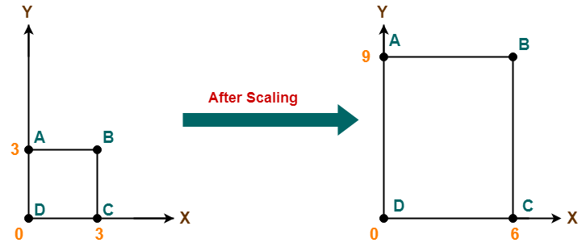

Slide 20
Matrix representation for translation, scaling and rotation.

Slide 21
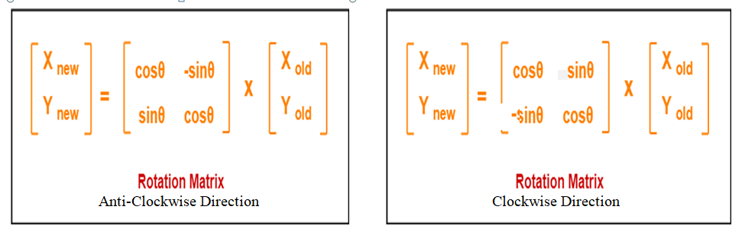
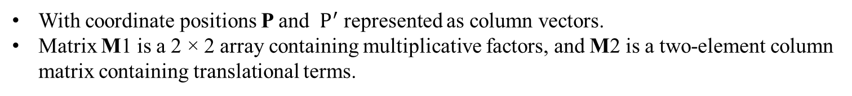
MATRIX REPRESENTATIONS
Each of the three basic two-dimensional transformations (translation, rotation, and scaling) can be expressed in the general matrix form
With coordinate positions P and $P^{′}$ represented as column vectors.
Matrix M1 is a 2 × 2 array containing multiplicative factors, and M2 is a two-element column matrix containing translational terms.

Slide 22
Homogeneous coordinates for translation, scaling and rotation.

Slide 23
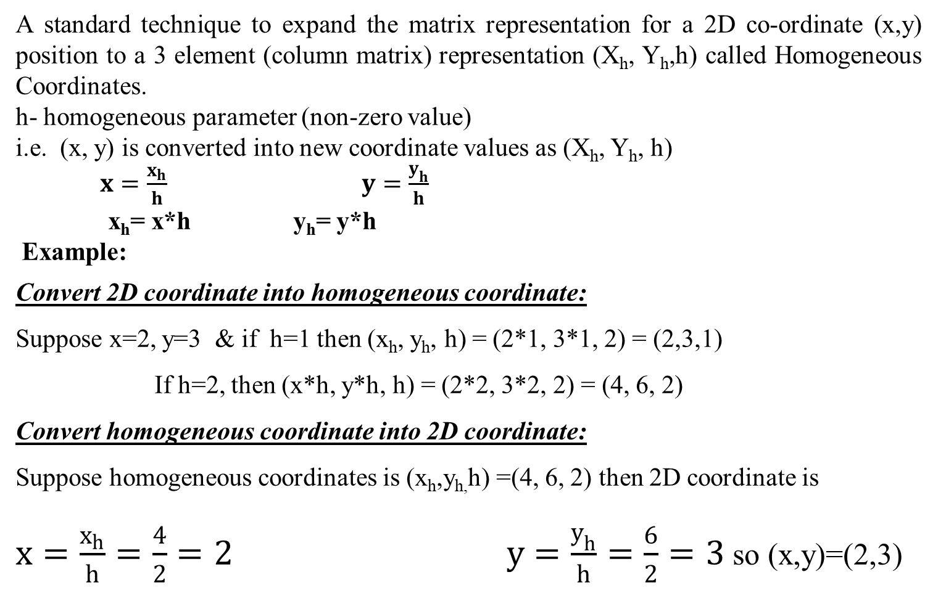
HOMOGENEOUS COORDINATES
A standard technique to expand the matrix representation for a 2D co-ordinate (x,y) position to a 3 element (column matrix) representation (X_{h}, Y_{h},h) called Homogeneous Coordinates.
h- homogeneous parameter (non-zero value)
i.e. (x, y) is converted into new coordinate values as (X_{h}, Y_{h}, h)
$x=\frac{x_{h}}{h}$ $y=\frac{y_{h}}{h}$
x_{h}= x*h y_{h}= y*h
Example:
Convert 2D coordinate into homogeneous coordinate:
Suppose x=2, y=3 & if h=1 then (x_{h}, y_{h}, h) = (2*1, 3*1, 2) = (2,3,1)
If h=2, then (x*h, y*h, h) = (2*2, 3*2, 2) = (4, 6, 2)
Convert homogeneous coordinate into 2D coordinate:
Suppose homogeneous coordinates is (x_{h},y_{h,}h) =(4, 6, 2) then 2D coordinate is
$x=\frac{x_{h}}{h}=\frac{4}{2}=2$ $y=\frac{y_{h}}{h}=\frac{6}{2}=3$ so (x,y)=(2,3)

Slide 24
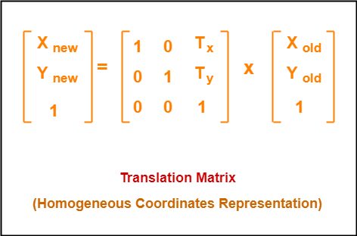
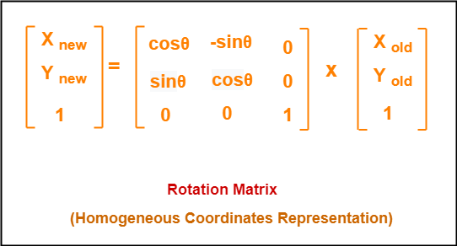
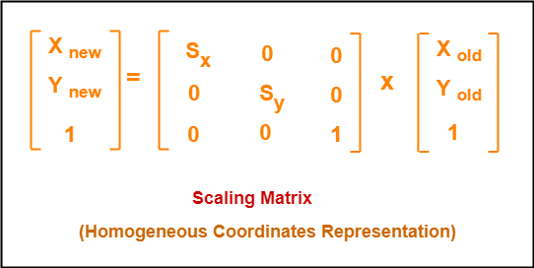

Slide 25



INVERSE TRANSFORMATIONS
For translation, the inverse matrix by negating the translation distances
An inverse rotation is accomplished by replacing the rotation angle by its negative (anti-clockwise).
An inverse scaling transformation by replacing the scaling parameters with their reciprocals. The inverse transformation matrix
An inverse matrix generates an opposite scaling transformations, so any scaling matrix multiply its inverse produces Identity Matrix.

Slide 26
2D Composite transformations

Slide 27

TWO-DIMENSIONAL COMPOSITE TRANSFORMATIONS
Forming products of transformation matrices is often referred to as a concatenation, or composition, of matrices if we want to apply two transformations to point position P, the transformed location would be calculated as
Where M= M2.M1
The coordinate position is transformed using the composite matrix M, rather than applying the individual transformations M1 and then M2.

Slide 28

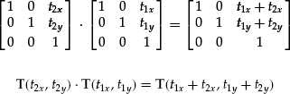
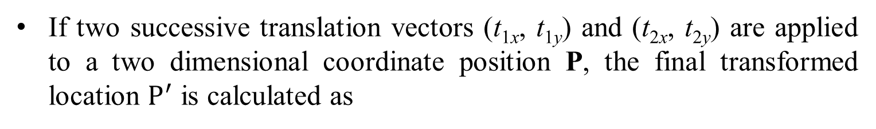
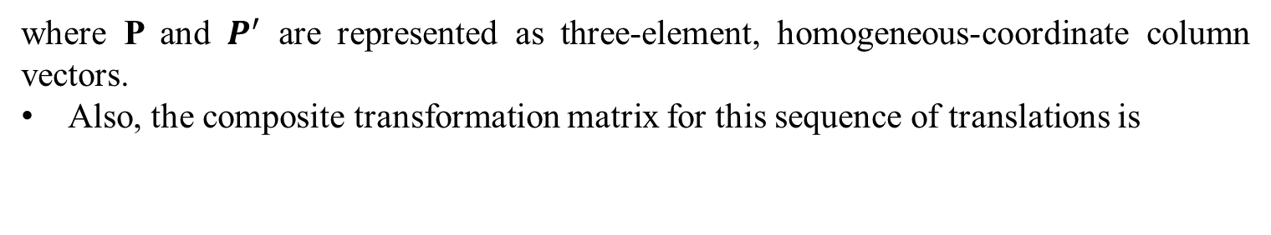
Composite Two-Dimensional Translations
If two successive translation vectors (t_{1x}, t_{1y}) and (t_{2x}, t_{2y}) are applied to a two dimensional coordinate position P, the final transformed location $P^{′}$ is calculated as
where P and $P^{′}$ are represented as three-element, homogeneous-coordinate column vectors.
Also, the composite transformation matrix for this sequence of translations is
This demonstrates 2 successive translation matrix are additive.

Slide 29

Composite Two-Dimensional Rotation
Two successive rotations applied to a point P produce the transformed position
By multiplying the two rotation matrices, we can verify that two successive rotations are additive:
R(θ2) · R(θ1) = R(θ1 + θ2)
So that the final rotated coordinates of a point can be calculated with the composite rotation matrix
P’ = R(θ1 + θ2) · P
This demonstrates 2 successive rotation matrix are additive.

Slide 30
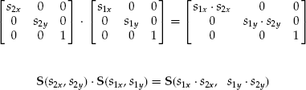
Composite Two-Dimensional Scaling
Concatenating transformation matrices for two successive scaling operations in two dimensions produces the following composite scaling
This demonstrates two successive scaling matrix are multiplicative.

Slide 31
General pivot point rotation and scaling

Slide 32
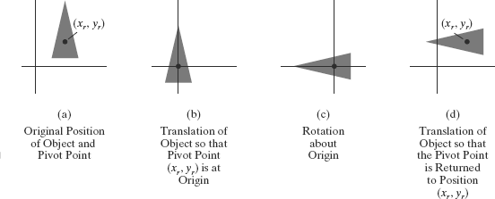
General Two-Dimensional Pivot-Point Rotation

Slide 33
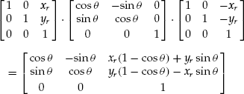
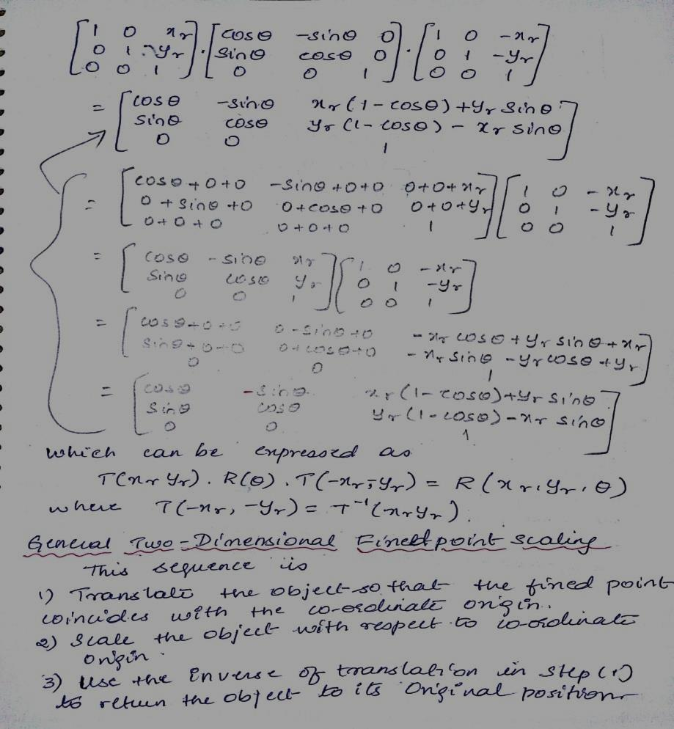
General Two-Dimensional Pivot-Point Rotation
We can generate a two-dimensional rotation about any other pivot point (x_{r} , y_{r} ) by performing the following sequence of translate-rotate-translate operations:
Translate the object so that the pivot-point position is moved to the coordinate origin.
Rotate the object about the coordinate origin.
Translate the object so that the pivot point is returned to its original position.
The composite transformation matrix for this sequence is obtained with the concatenation
Refer this for Matrix Multiplication
which can be expressed in the form
where T(−x_{r} , −y_{r} ) = T⁻¹(x_{r} , y_{r} )

Slide 34
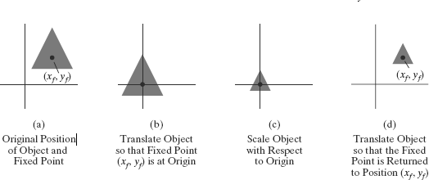
General Two-Dimensional Pivot-Point Scaling

Slide 35
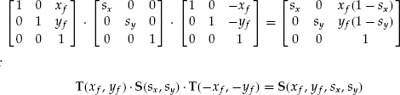
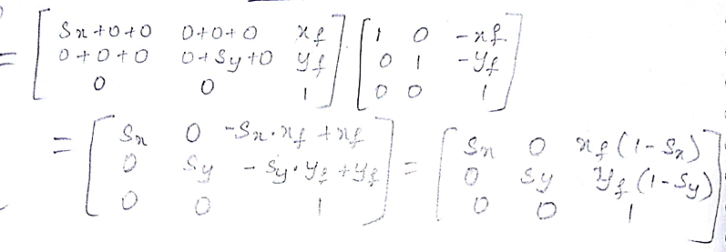
General Two-Dimensional Pivot-Point Scaling
To produce a two-dimensional scaling with respect to a selected fixed position (x _{f} , y_{f} ), when we have a function that can scale relative to the coordinate origin only. This sequence is
Translate the object so that the fixed point coincides with the coordinate origin.
Scale the object with respect to the coordinate origin.
Use the inverse of the translation in step (1) to return the object to its original position.
Concatenating the matrices for these three operations produces the required scaling matrix:
Refer this for Matrix Multiplication

Slide 36
OpenGL 2D Geometric Transformation Functions

Slide 37
Translation matrix is constructed with the following routine:
glTranslate*(tx, ty, tz);
Translation parameters tx, ty, and tz can be assigned any real-number values, and the single suffix code to be affixed to this function is either f (float) or d (double).
For two-dimensional applications, we set tz = 0.0;
example: glTranslatef (25.0, -10.0, 0.0);
Rotation matrix is generated with
glRotate*(theta, vx, vy, vz);
where the vector v = (vx, vy, vz) can have any floating-point values for its components defines the orientation for a rotation axis that passes through the coordinate origin.
The suffix code can be either f or d, and parameter theta is to be assigned a rotation angle in degree
For example, the statement: glRotatef (90.0, 0.0, 0.0, 1.0);
Scaling matrix with respect to the coordinate origin with the following routine:
glScale* (sx, sy, sz);
The suffix code is again either f or d, and the scaling parameters can be assigned any real-number values.
Scaling in a two-dimensional system involves changes in the x and y dimensions, so a typical two-dimensional scaling operation has a z scaling factor of 1.0
Example: glScalef (2.0, -3.0, 1.0);

Slide 38
Basics of 2D viewing and Clipping:

Slide 39
Basics of 2D viewing :

Slide 40
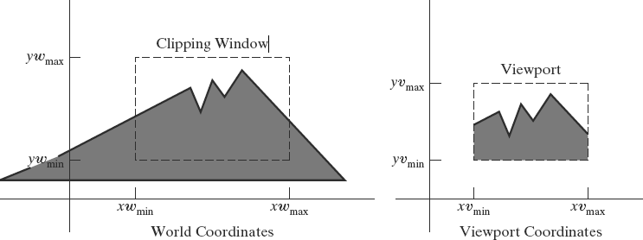
2D Viewing Pipeline
A section of a two-dimensional scene that is selected for display is called a clipping Window.
Clipping window is referred as the world window or the viewing window
Graphics packages allow us also to control the placement within the display window using another “window” called the viewport.
Clipping window- selects what we want to see
Viewport – indicates where it is to be viewed on the output device
Clipping windows and viewports are rectangles in standard position, with the rectangle edges parallel to the coordinate axes.
Consider only rectangular viewports and clipping windows, as illustrated in Figure

Slide 41
2D Viewing Pipeline Architecture
The mapping of a two-dimensional world-coordinate scene description to device coordinates is called a 2D viewing transformation.
This transformation is referred as window-to-viewport transformation or the windowing transformation as shown in fig next slide.

Slide 42
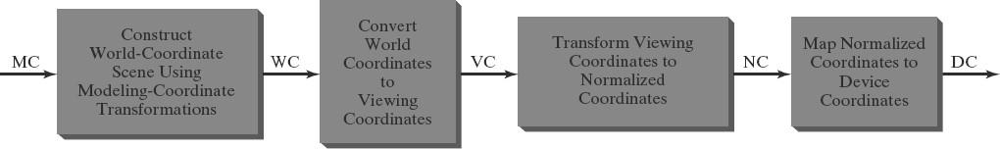
2D Viewing Pipeline Architecture
Once a world-coordinate scene has been constructed, set up a separate 2D viewing coordinate reference frame for specifying the clipping window.
To make the viewing process independent of the requirements of any output device, graphics systems convert object descriptions to normalized coordinates and apply the clipping routines.
Systems use normalized coordinates in the range from 0 to 1, and others use a normalized ranges from −1 to 1.
At the final step of the viewing transformation, the contents of the viewport are transferred to positions within the display window.
Clipping is usually performed in normalized coordinates, allows us to reduce computations by first concatenating the various transformation matrices ranges from −1 to 1.

Slide 43
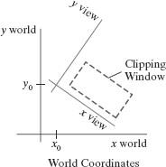
Viewing Transformation systems :
1. Viewing-Coordinate Clipping Window
A general approach to the two-dimensional viewing transformation is to set up a viewing coordinate system within the world-coordinate frame
Choose an origin for a two-dimensional viewing-coordinate frame at some world position P0 = (x0, y0), and establish the orientation using a world vector V that defines the yview direction.
Vector V is called the two-dimensional view up vector.
An alternative method is to give a rotation angle relative to either the x or y axis in the world frame.
The first step in the transformation sequence is to translate the viewing origin to the world origin.

Slide 44
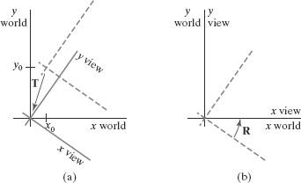
Viewing-Coordinate Clipping Window (cont..)
Next, we rotate the viewing system to align it with the world frame.
Given the orientation vector V, we can calculate the components of unit vectors v = (vx, vy) and u = (ux, uy) for the yview and xview axes, respectively.
Where,
T is the translation matrix,
R is the rotation matrix
A viewing-coordinate frame is moved into coincidence with the world frame is shown in below figure
(a) applying a translation matrix T to move the viewing origin to the world origin, then
(b) applying a rotation matrix R to align the axes of the two systems.

Slide 45
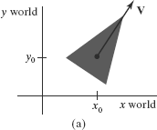
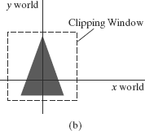
2. World-Coordinate Clipping Window
A routine for defining a standard, rectangular clipping window in world coordinates is provided in a graphics-programming library.
Simply specify two world-coordinate positions, which are then assigned to the two opposite corners of a standard rectangle.
Once the clipping window has been established, the scene description is processed through the viewing routines to the output device.
Thus, we simply rotate (and possibly translate) objects to a desired position and set up the clipping window all in world coordinates.
triangle
(a) with a selected reference point and orientation vector, is translated and rotated to position
(b) within a clipping window.

Slide 46
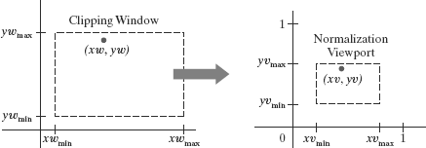
3. Normalization and Viewport Transformations
The viewport coordinates are often given in the range from 0 to 1 so that the viewport is positioned within a unit square.
After clipping, the unit square containing the viewport is mapped to the output display device.
3.1 Mapping the Clipping Window into a Normalized Viewport
First consider a viewport defined with normalized coordinate values between 0 and 1.
Object descriptions are transferred to this normalized space using a transformation that maintains the same relative placement of a point in the viewport as it had in the clipping window Position (xw, yw) in the clipping window is mapped to position (xv, yv) in the associated viewport.

Slide 47



To transform the world-coordinate point into the same relative position within the viewport, we require that
Solving these expressions for the viewport position (xv, yv), we have
xv = sxxw + tx yv = syyw + ty
Where the scaling factors are
and the translation factors are

Slide 48
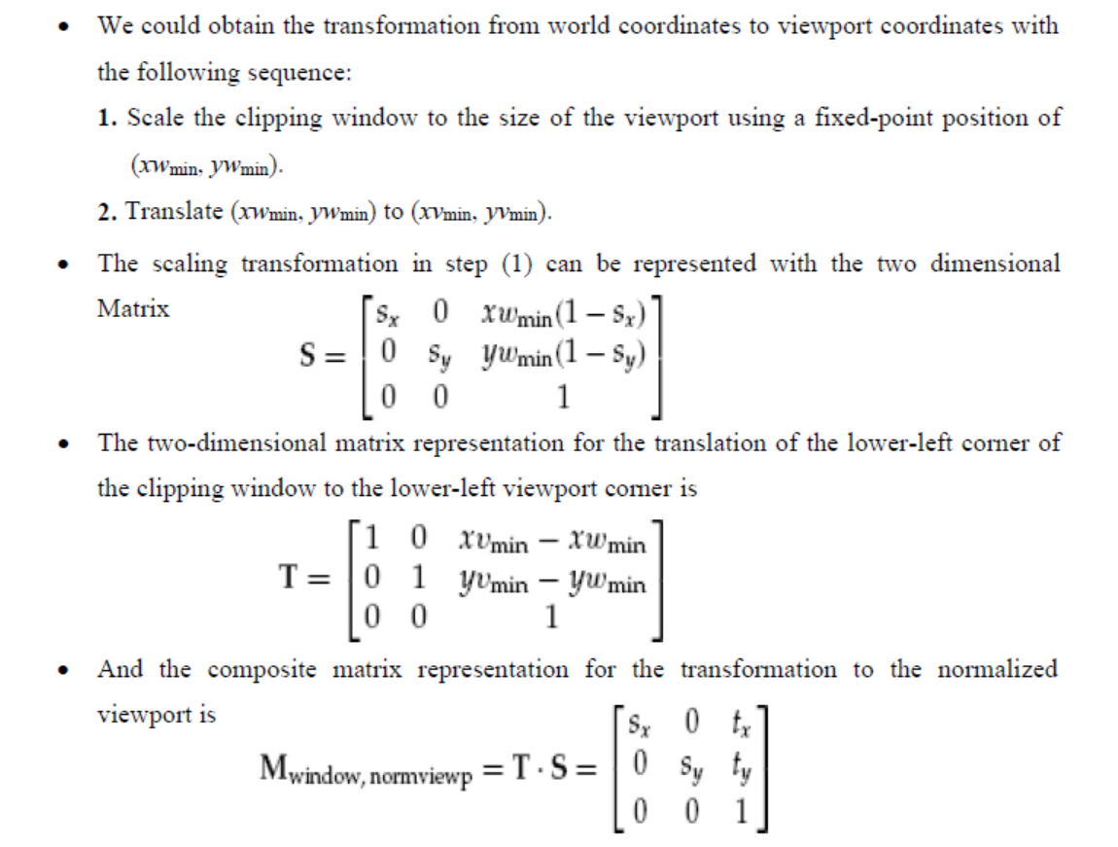

Slide 49
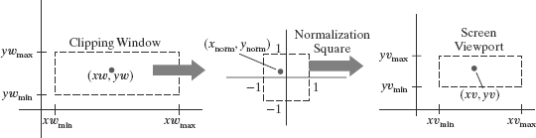
2. Mapping the Clipping Window into a Normalized Square
Another approach to two-dimensional viewing is to transform the clipping window into a normalized square, clip in normalized coordinates, and then transfer the scene description to a viewport specified in screen coordinates.
This transformation is illustrated in Figure below with normalized coordinates in the range from −1 to 1

Slide 50
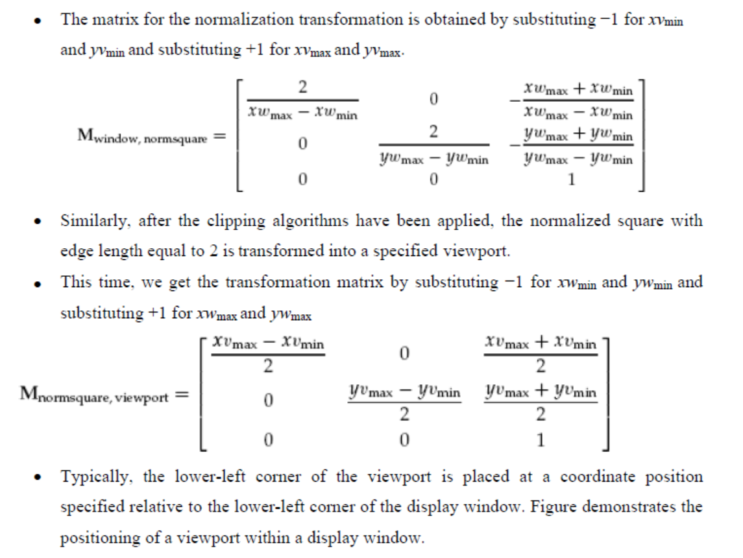

Slide 51


